Slide 1
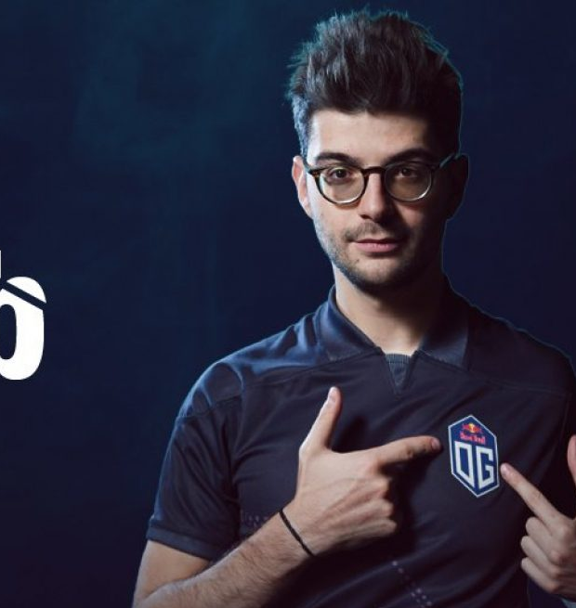
Ceb's Content Plan
By Logan Wright

Slide 2
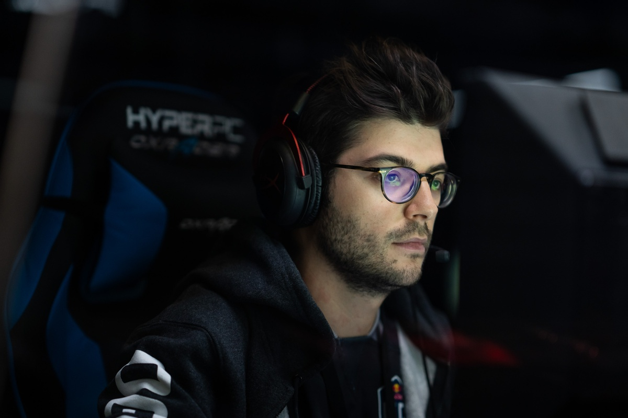
Ceb
Full Name: Sébastien Debs
Alias: Ceb
Birthdate: May 11, 1992
Nationality: French-Lebanese
Success: Has won back-to-back TI’s
Team: OG
Game: Dota 2

Slide 3
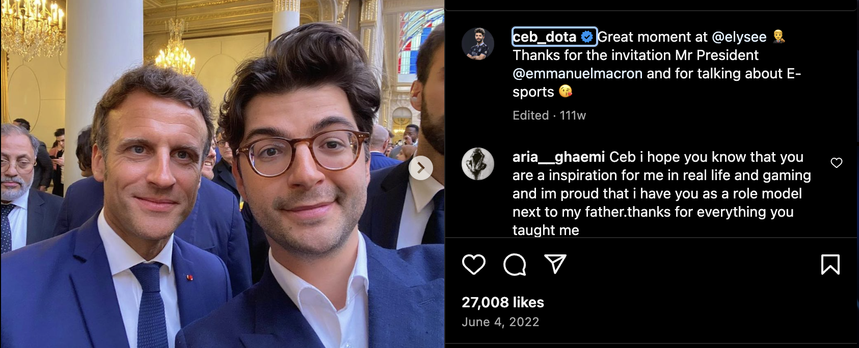
Instagram Content Strategy
Frequency: 5 post per week
Strategy:
Post short and long videos of the gameplay
Tournaments
Personal other than Dota 2
Game day BTS
short messages and engaging questions and answers.
Create Reels with fun short videos, creative prompts, and issues of interest.
Rationale:
Sharing bits of information in the form of pictures and videos through images. This platform make it easier for Ceb to share parts of him to get fans feel like they personally know him.

Slide 4
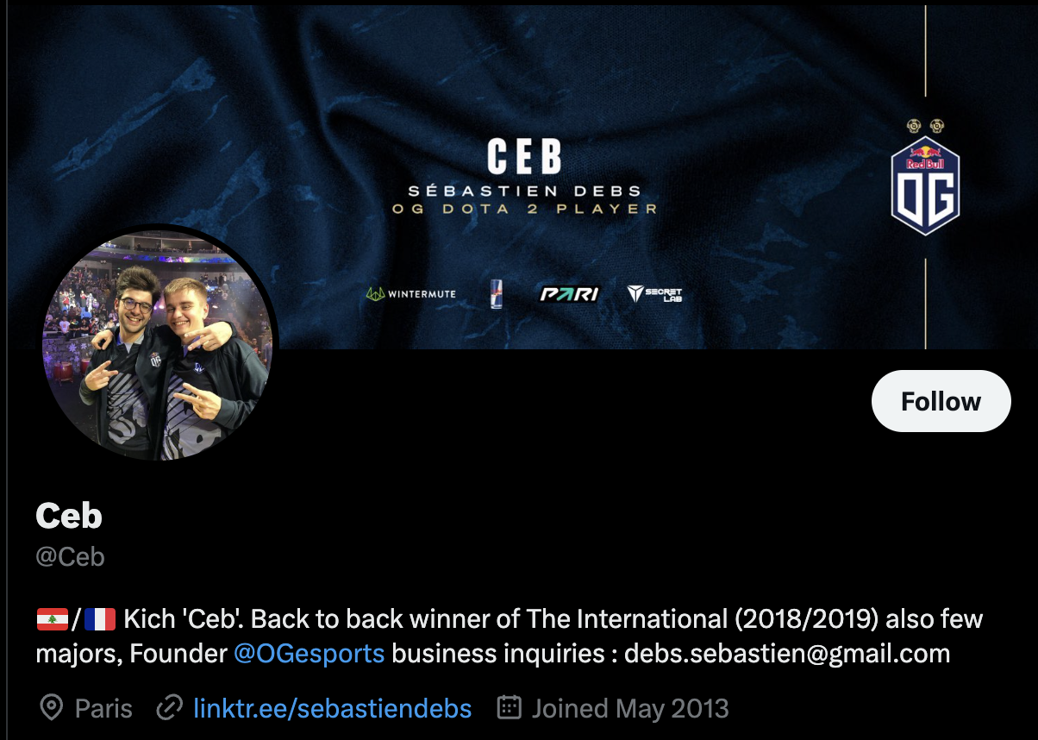
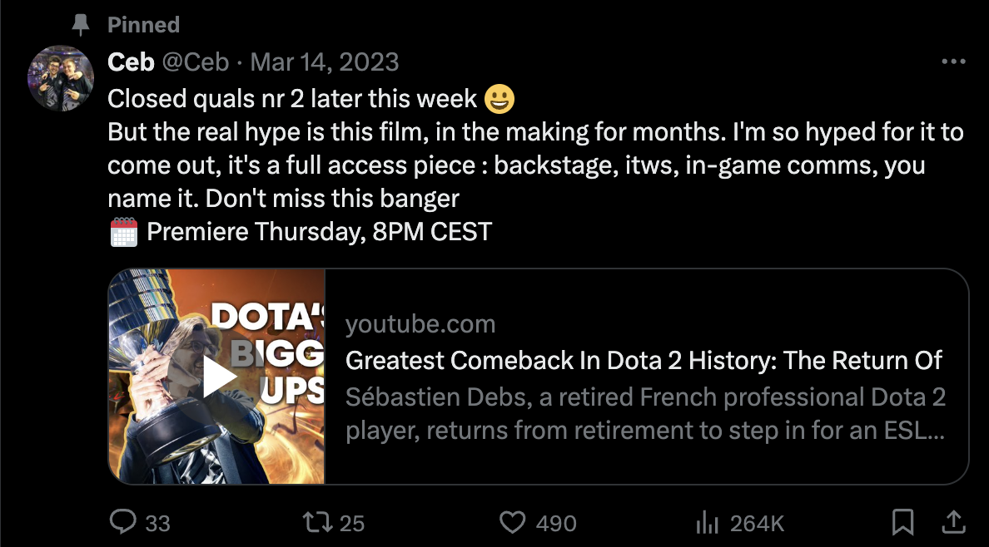
Twitter Content Strategy
Frequency: 7 posts per week.
Strategy:
Give running comments and photos during tournaments, matches, and practices.
Directly ask fans for their opinion on polls or respond to fan questions and retweets of fan-created content.
Discuss the general information about the esports industry and the strategies of the OG team.
Discuss OG team plan
Have a social media rep. post on twitter
Last post, last March 2023
Rationale:
Enables an immediate and fast response, which is convenient when responding to the esports/Dota community.

Slide 5
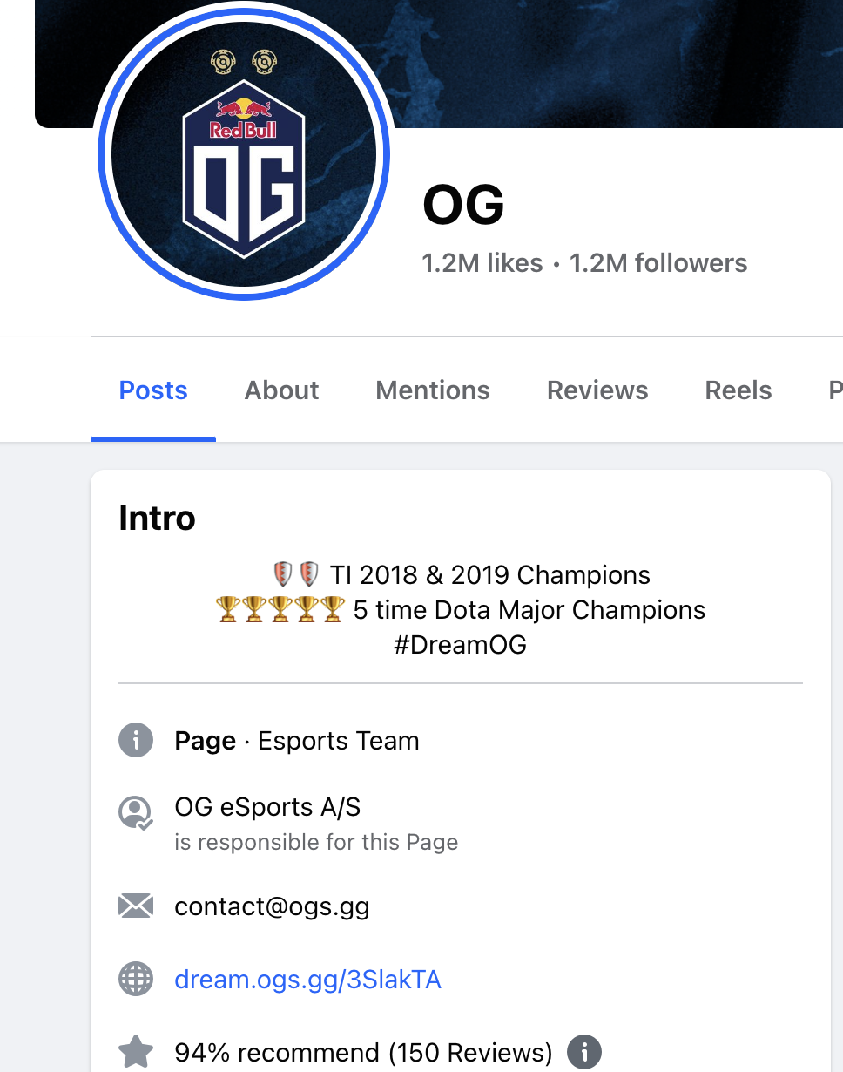
Facebook Content Strategy
Frequency: 1 posts per week.
Strategy:
Inform the viewers about the next tournaments, matches, and news of the teams.
Use it for posting longer pieces
Give new players advice
Host contests for fans and give aways
Use Facebook Live
Create a Facebook page
Rationale:
statuses and events and assist in creating a Fan base through specific content.

Slide 6
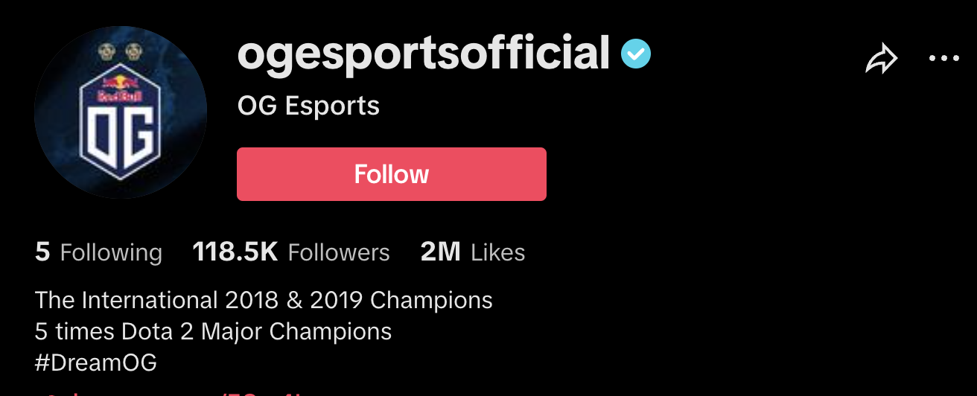
TikTok Content Strategy
Frequency: 2 posts
Strategy:
Post short, amusing, and thrilling videos which can include hangout sessions, game sessions, and challenges
Join trends with other esports player
Create a TikTok associated with OG team
Rationale:
short videos are ideal for targeting young audiences and producing viral content.

Slide 7
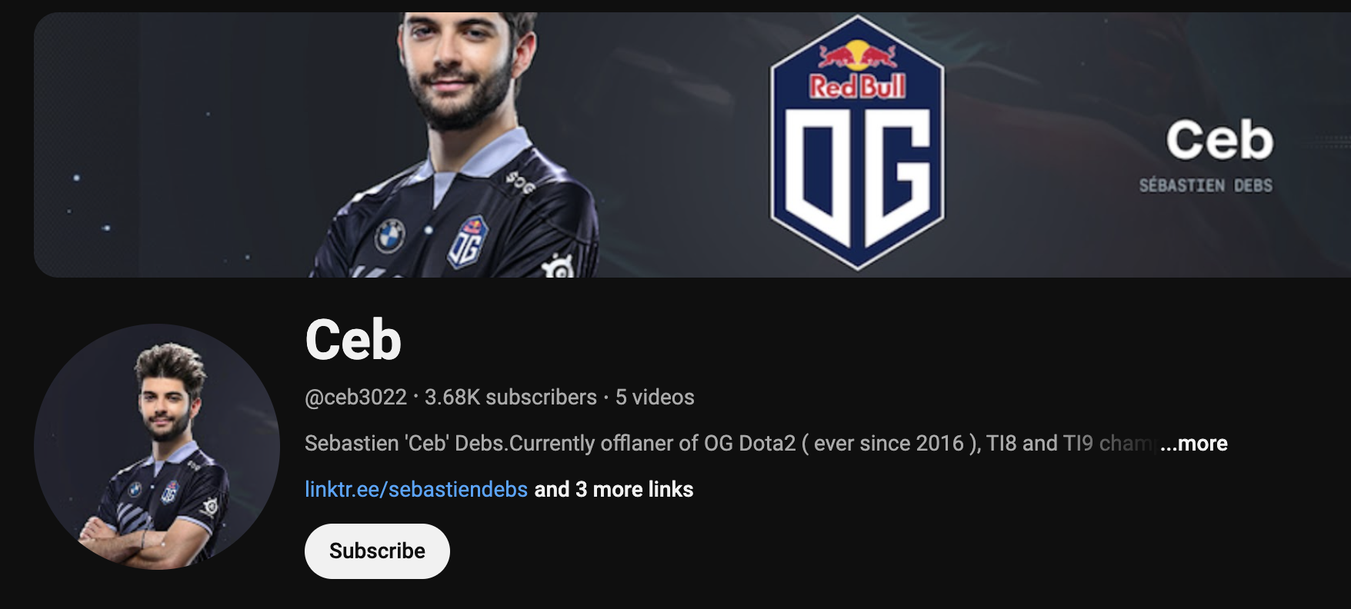
YouTube Content Strategy
Frequency: 2 posts per week
Strategy:
Upload long-form content such as match highlights
gaming tutorials
Vlogs on game day
Personal Vlogs
Create series-based content like weekly recaps, Q&A sessions, and behind-the-scenes videos.
Post more often
Rationale:
ideal for in-depth, high-quality video content, allowing Ceb to build a comprehensive video library and attract dedicated viewers.

Slide 8
